Slide 1
Anime RecommendationSystem
MEMBERS OF THE TEAM
KUNAL MALLICK
24167002
ANUSHKA KHATUA
24167030
SOHAM ADHIKARI
24167029
KUNAL MALLICK
24167002

Slide 2
Overview
Develop an anime recommendation system using a deep learning model to provide personalized recommendations.
Key Features:
Utilizes advanced DL techniques.
Works with real-world anime datasets.
Enhances user engagement and satisfaction.

Slide 3
Motivation
Why build an anime recommendation system?
The growing popularity of anime worldwide.
Challenge of navigating massive anime libraries.
Lack of personalized recommendations in existing platforms.
Improve user experience and retention.
Significance:
Bridges the gap between users and their preferred anime genres.
Promotes lesser-known, high-quality anime.

Slide 4
problem formulation
Predict anime preferences for users based on historical data and content features.
Key Challenges:
High dimensionality of user-anime interaction data.
Sparse user preference matrices.
Diverse anime genres and user profiles.
Problem Statement:
"Given a dataset of users, anime items, and interactions, build a model to recommend the top 10 anime for each user."

Slide 5

Proposed Model Details
Model Architecture
[Specify the DL model type: Neural Collaborative Filtering (NCF), Autoencoders, Transformer, etc.]
Layers, activation functions, and optimizers used.
Mathematics:
Objective Function :
Model components: Embeddings, dense layers, etc.
Optimization technique (e.g., Adam optimizer).

Slide 6
dataset description
This data set contains information on user preference data from 73,516 users on 12,294 anime. Each user is able to add anime to their completed list and give it a rating and this data set is a compilation of those ratings.
Anime.csv (12294 rows × 7 columns)
anime_id - myanimelist.net's unique id identifying an anime.
name - full name of anime.
genre - comma separated list of genres for this anime.
type - movie, TV, OVA, etc.
episodes - how many episodes in this show.
rating - average rating out of 10 for this anime.
members - number of community members that are in this anime's "group".
Rating.csv (7813737 rows × 3 columns)
user_id - non identifiable randomly generated user id.
anime_id - the anime that this user has rated.
rating - rating out of 10 this user has assigned

Slide 7
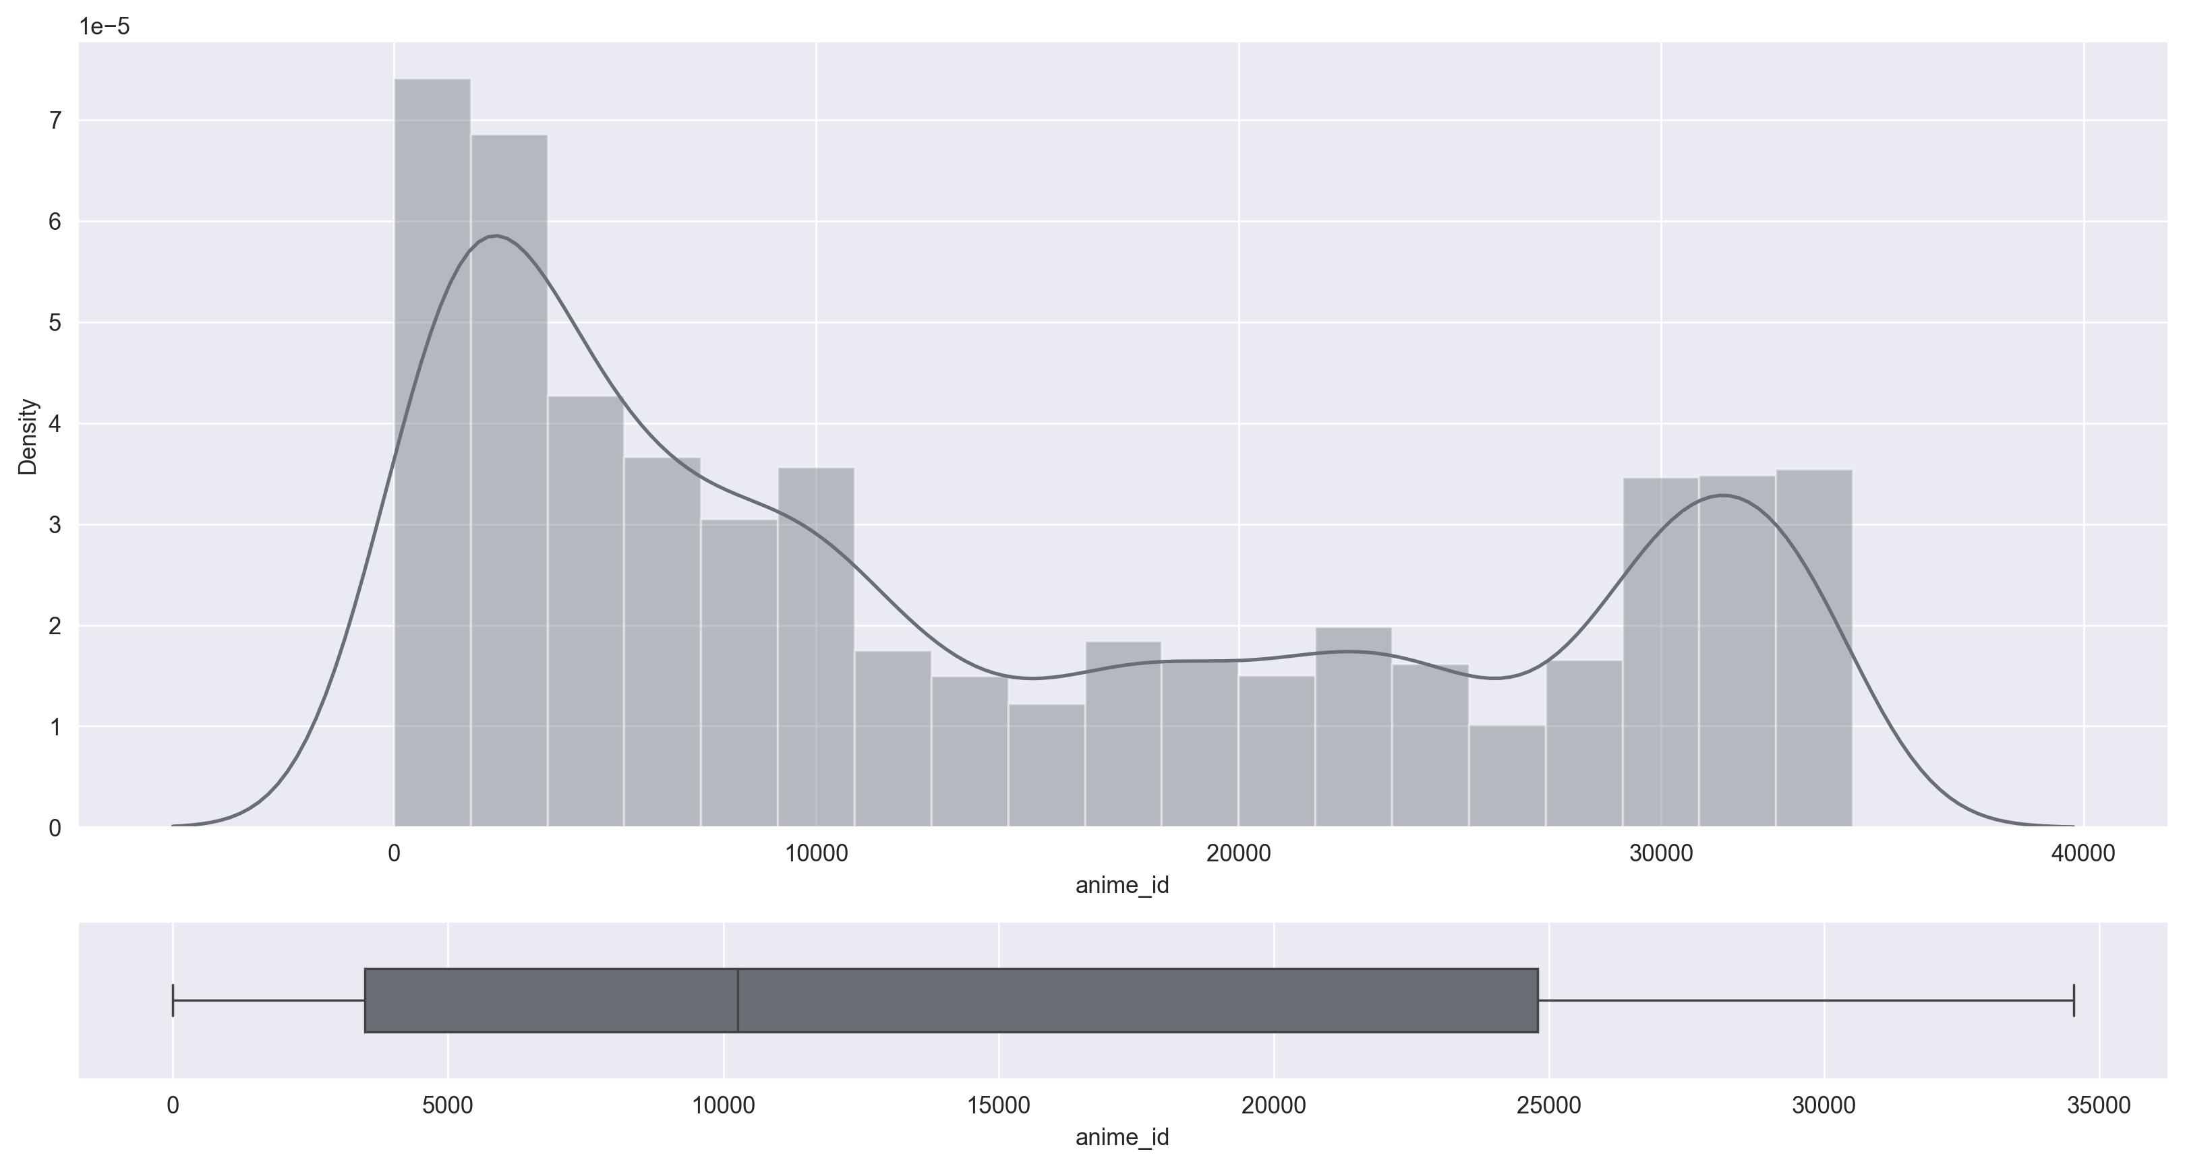
anime_id
type : int64
unique : 12294
min : 1
max : 34527
missing : 0(0.0%)

Slide 8
name
Type : object
unique : 12292
missing : 0(0.0%)

Slide 9
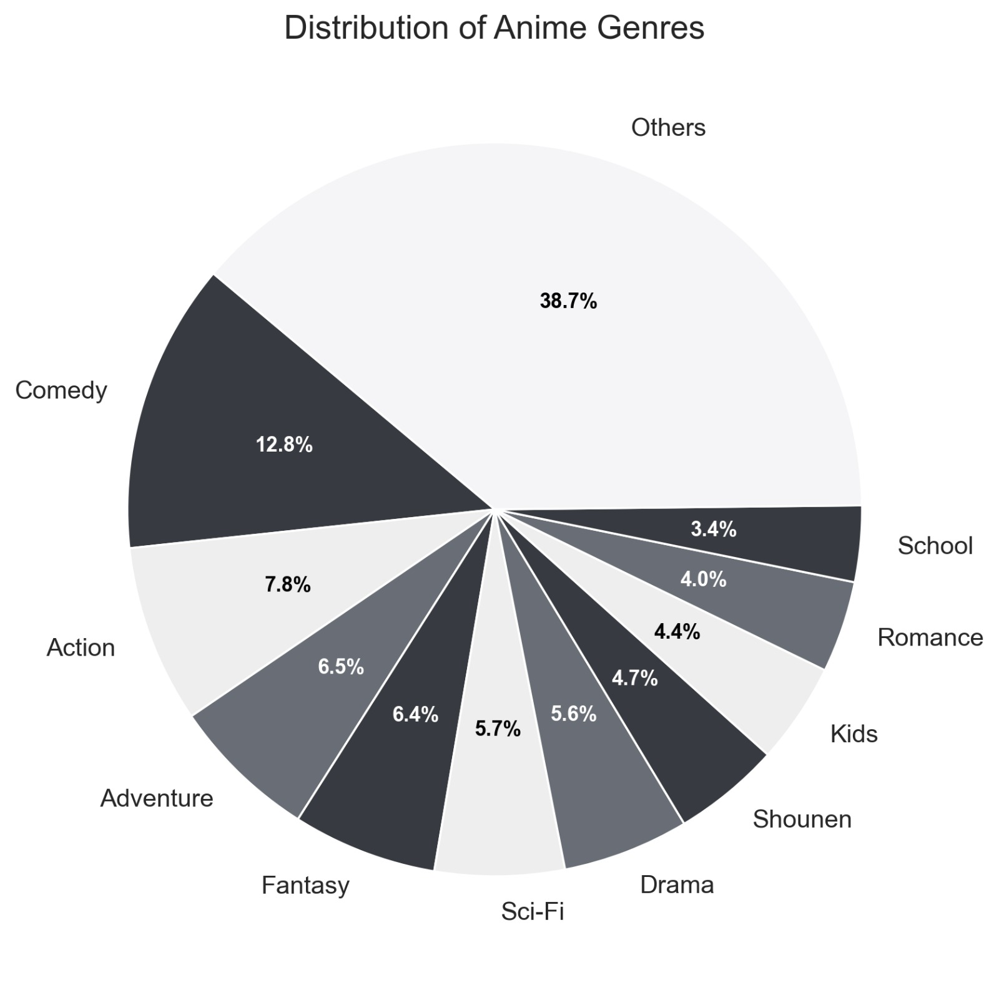
genre
Type : object
unique : 3265
missing : 62(0.5%)

Slide 10
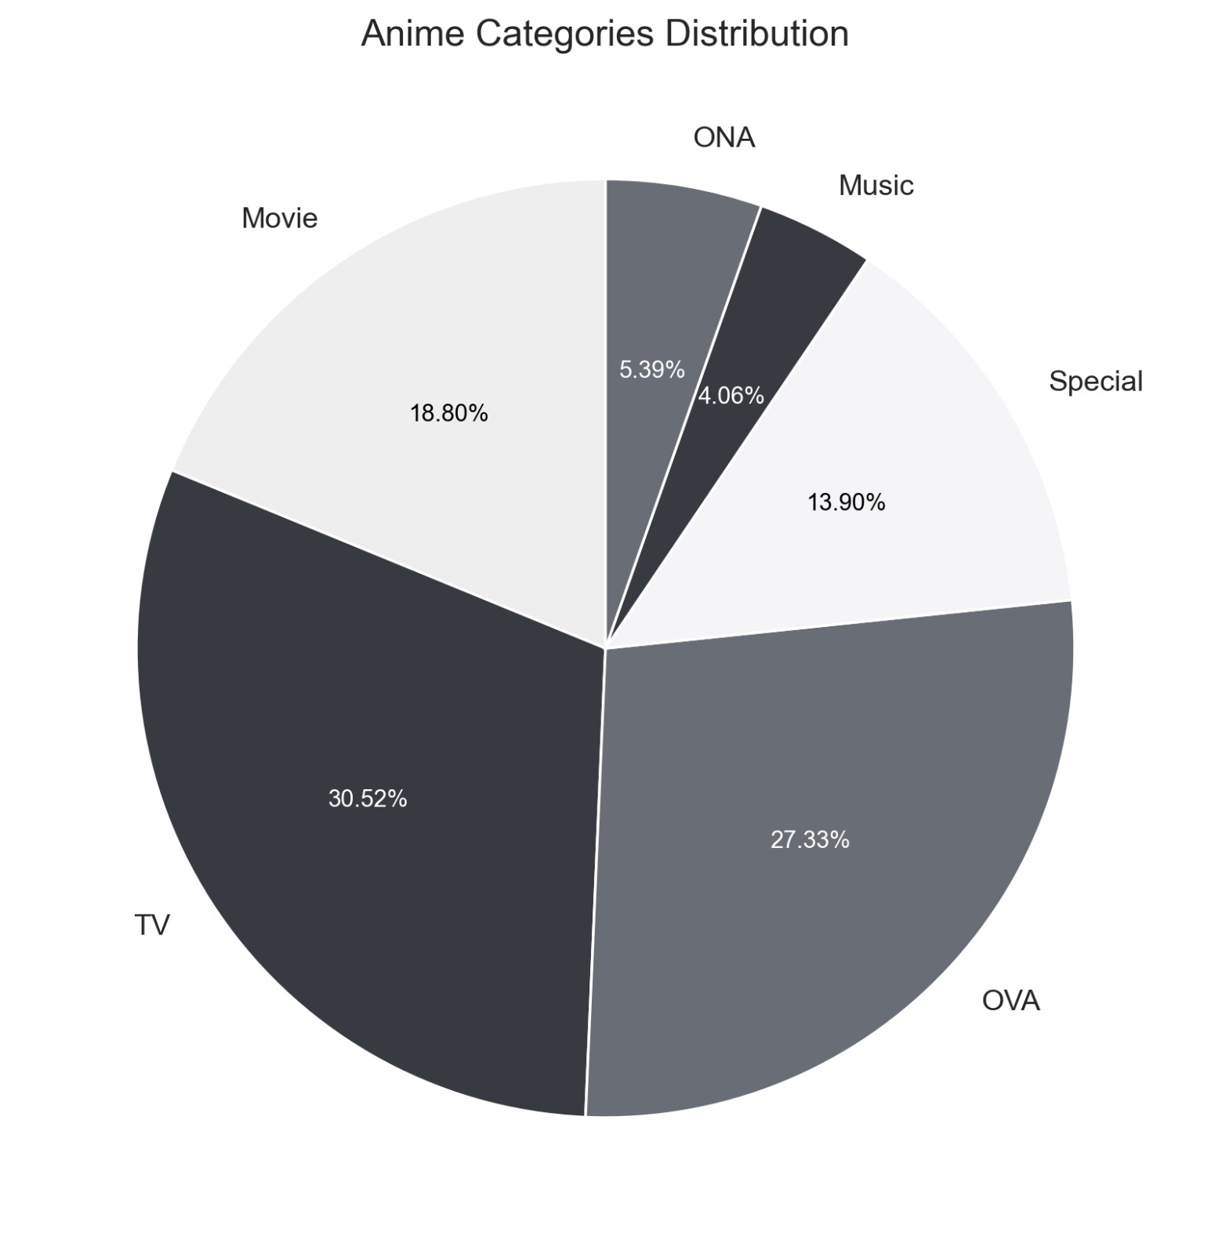
type
Type : object
unique : 6
missing : 25(0.2%)

Slide 11
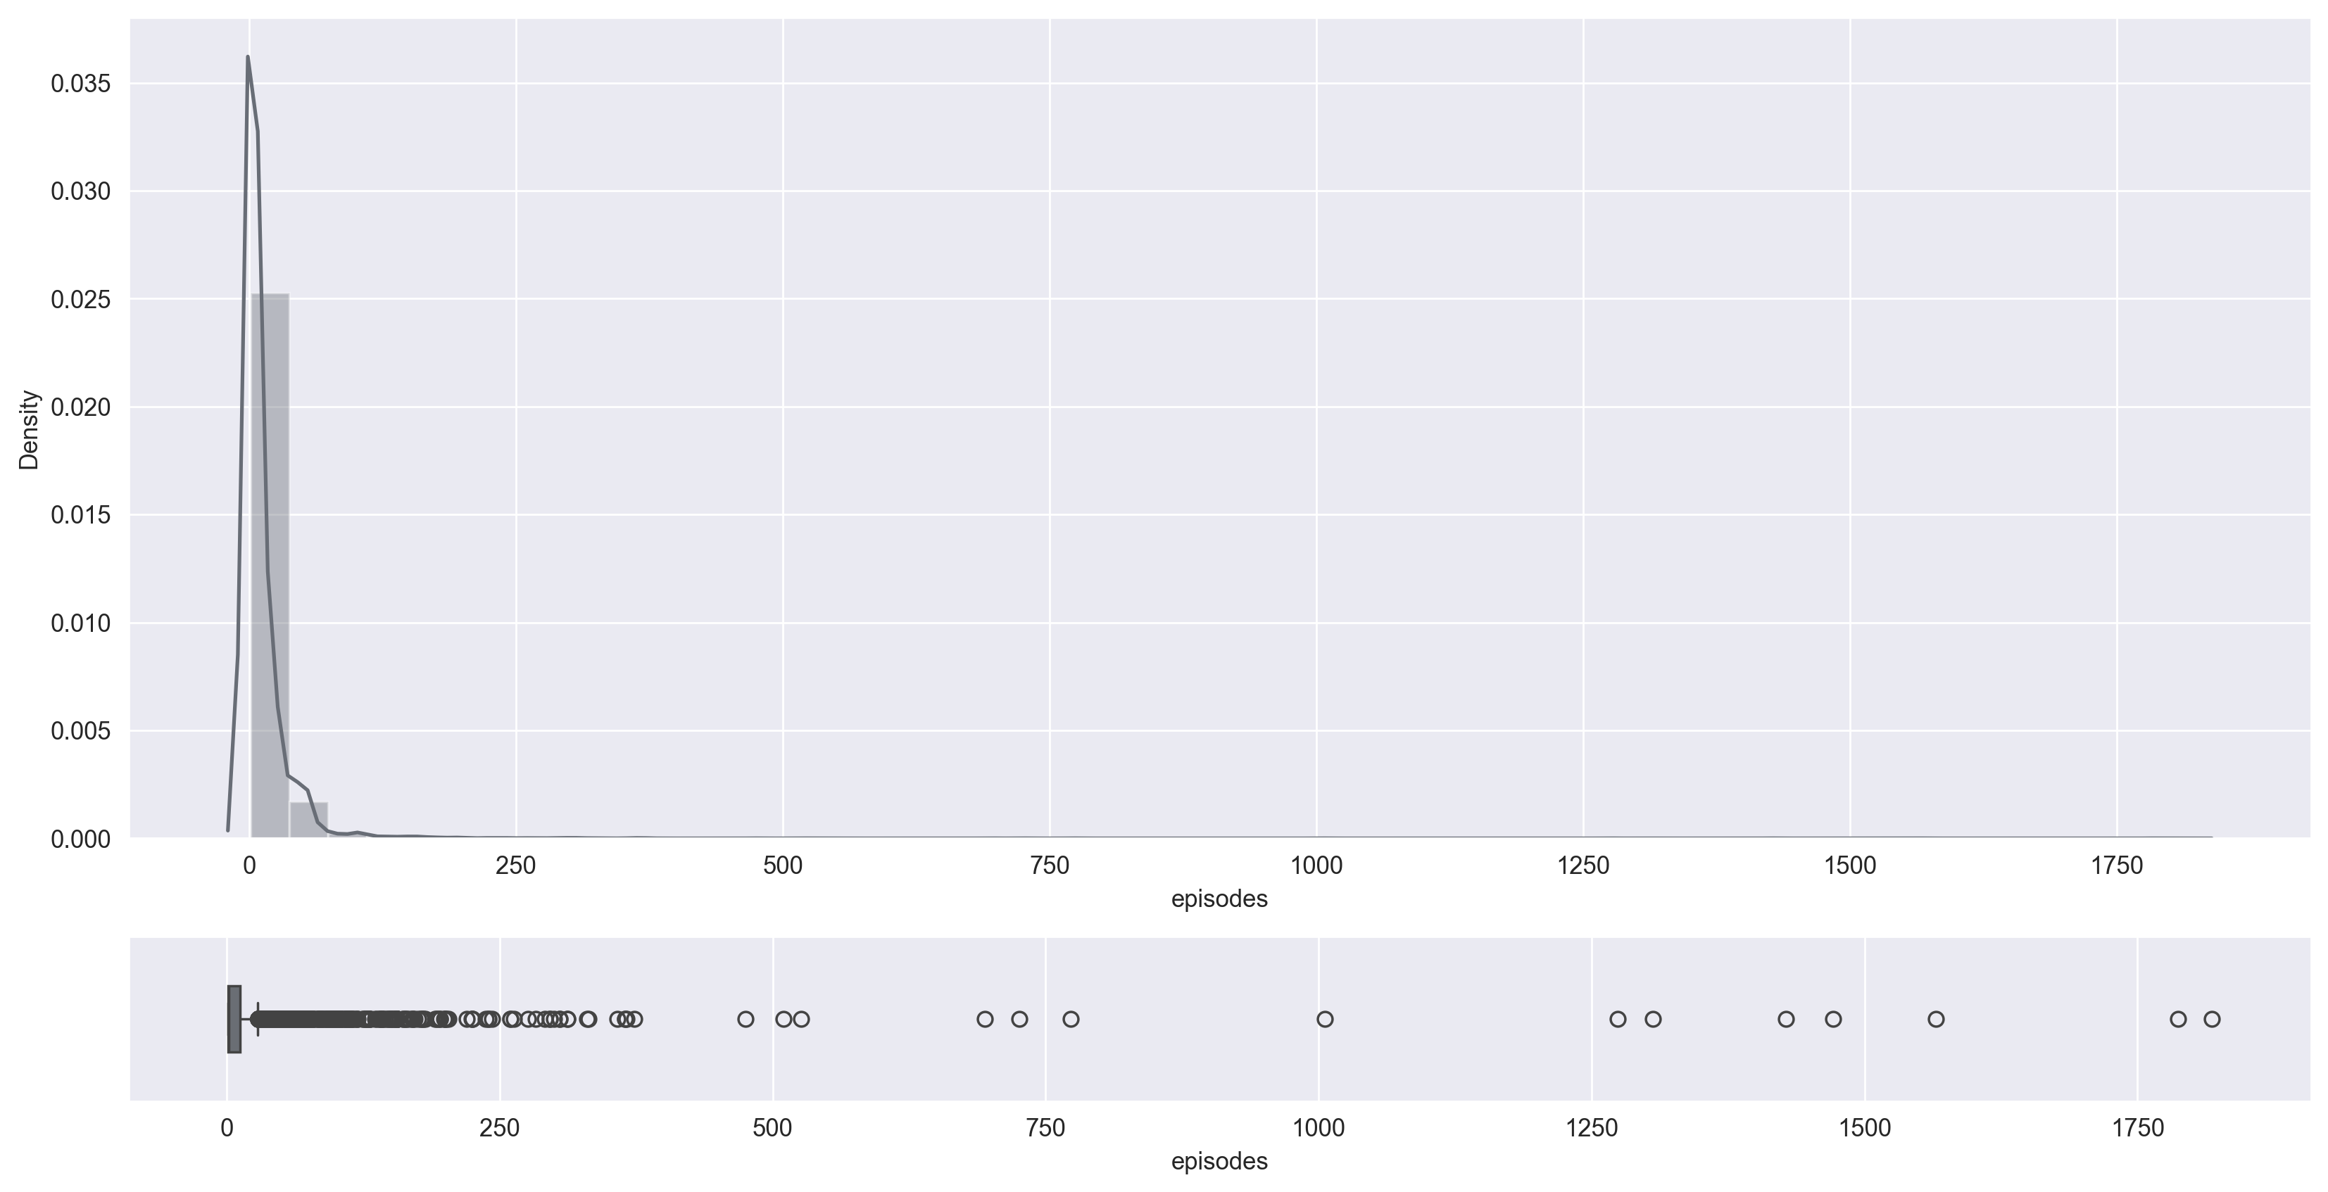
episodes
Type : int64
unique : 187
missing : 0(0.0%)

Slide 12
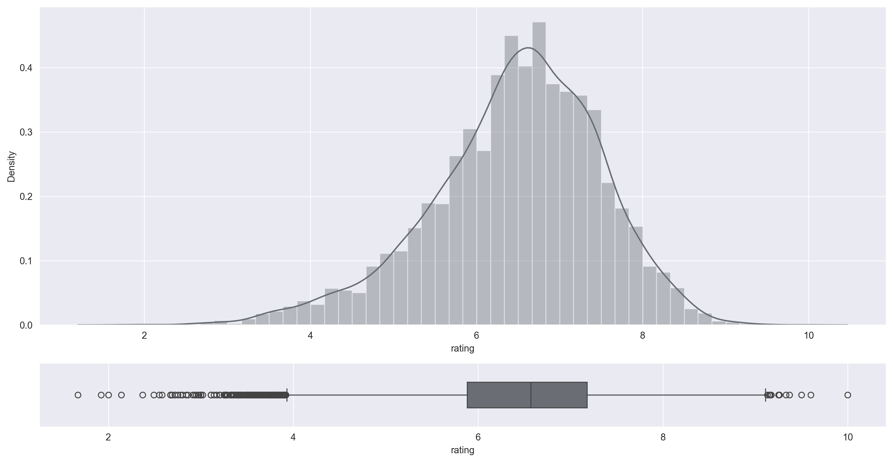
rating
type : float64
mean : 6.47
median : 6.57
std : 1.03
unique : 599
min : 1.67
max : 10.0
25% : 5.88
75% : 7.18
missing : 230(1.87%)
Outlier : 1.86%

Slide 13
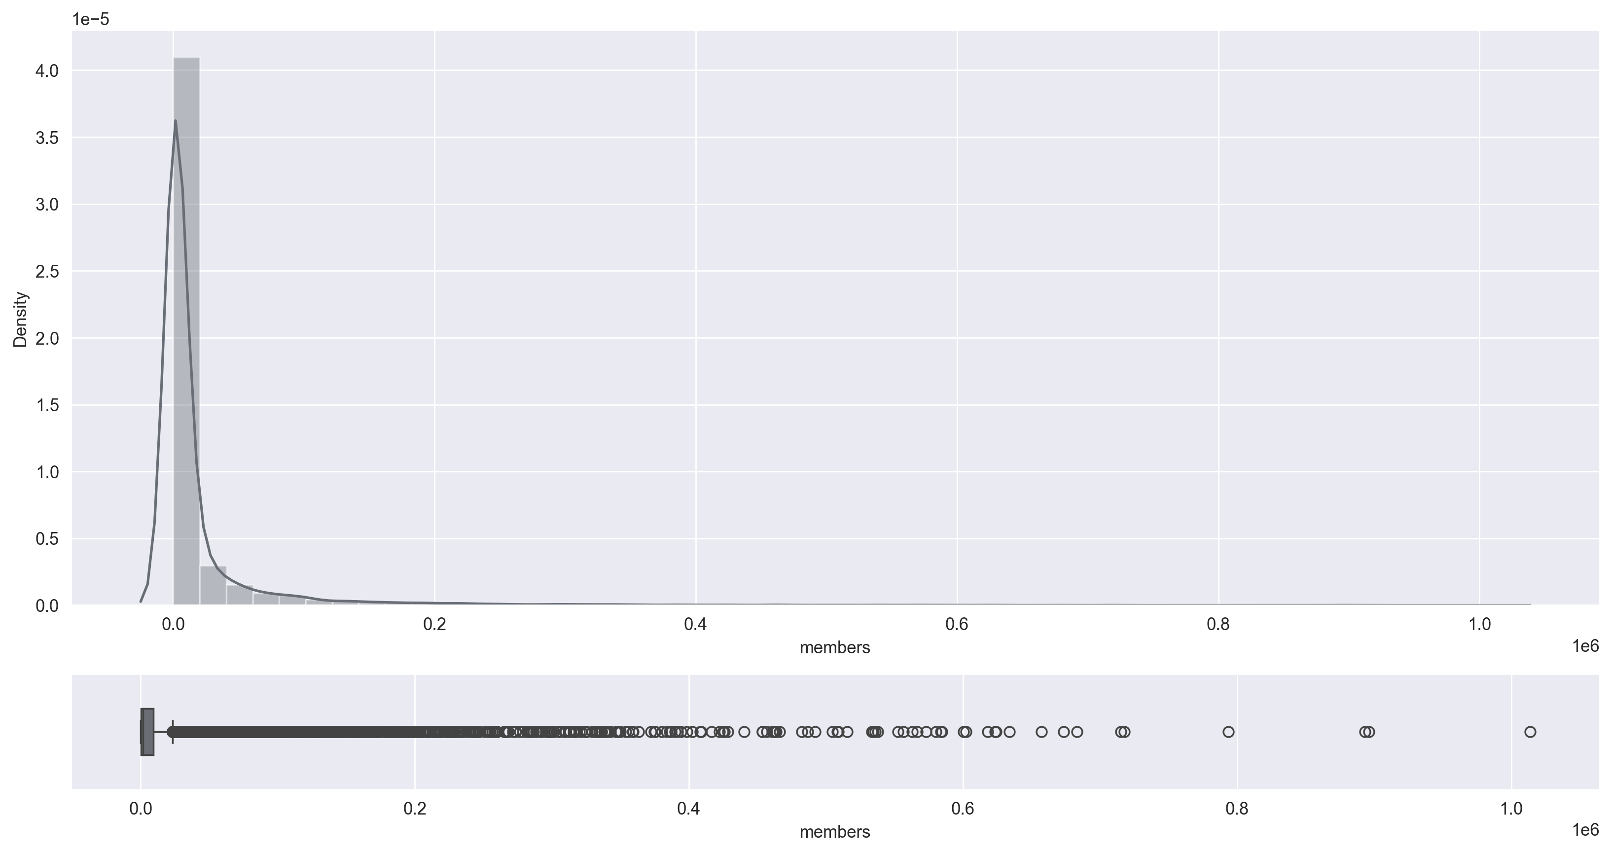
members
type : int64
mean : 18071.34
median : 1550.0
std : 54820.68
unique : 6706
min : 5
max : 1013917
25% : 225.0
75% : 9437.0
missing : 0(0.0%)

